Slide 1
Retirement Investment Project
CIT3002 - Analysis of Algorithms
Group Members:
Andre Campbell (2301103)
Chevannese Ellis (2301109)
Marco Mclean (2209181)
Shanika Mcleggan (1503802)

Slide 2
01
Introduction

Slide 3

Introduction
Using Java, we implement fixed and variable interest rate simulations, depletion modeling, and binary search-based optimization via successive approximation. The solution adheres to the divide-and-conquer paradigm, ensuring polynomial-time efficiency
(O(n log M)).

Slide 4
02
Fixed Investor Theory

Slide 5
Fixed Investor
The FixedInvestor function basically calculates the future value of an investment with a fixed annual interest rate over a certain number of years.
Inputs
principal (P) → the initial amount of money invested
rate (r) → the annual interest rate
years (n) → how long the money is invested

Slide 6
Fixed Investor
Algorithm Classification
The algorithm belongs to computational Class P (Polynomial Time) because it performs a finite number of operations based on the number of years. The computation involves a constant number of operations per year (multiplication and addition), so time complexity is O(n) where n = years.

Slide 7
Fixed Investor Pseudocode
FUNCTION fixedInvestor (principal, rate, years):
balance = principal
FOR i = 1 TO years STEP 1
balance = balance * (1 + rate)
RETURN balance
END FUNCTION

Slide 8
Fixed Investor
Asymptotic Efficiency
The Fixed Investor function uses an iterative approach with a for-loop to update the balance each year.
It initializes balance with the principal in constant time.
The loop runs from year 1 to n, performing the same set of operations each iteration (multiplying by rate + 1).
Memory usage is constant (O(1)) since only simple variables are stored (no arrays or lists).
Time complexity is O(n) because calculations are performed once per year.
Tradeoff: slower than the direct formula for very large n because it computes every year sequentially.
Another tradeoff: cannot directly get the balance for a later year without calculating all previous years.

Slide 9
03
Variable Investor Theory

Slide 10
Variable Investor
Inputs
principal (P) → amount invested
rate (r) → the annual interest rate for each year
The variableInvestor() function is designed to simulate the growth of a retirement investment under variable annual interest rates, which may be positive or negative.This function takes into consideration the fluctuating market conditions that affect the investment year by year.

Slide 11
Variable Investor
Algorithmic Efficiency
The algorithm begins by assigning the initial value of principal to a variable we called ‘balance’.
The assignment is a constant time operation and does not scale with the input size.
Most of the work occurs in the FOR loop, which processes each interest rate one at a time.
For every rate given in the list, the algorithm executes a fixed set of operations.
The operations include adding 1 to the rate, multiplying the result by the current balance and updating the balance variable as it increases.
The operations will take constant time regardless of the size of the numbers because the loops run once for each rate which results in the operations growing proportional to n. In this algorithm there are no nested loops or recursion that depend on n therefore we concluded that the complexity is linear O(n).

Slide 12
04
Finally Retired Theory

Slide 13
Finally Retired
Inputs
Balance (b) → the initial savings at the end of retirement
Withdrawal amount(r) → the withdrawal amount for each year
years (n) → how many years until withdraw can’t take place
The Finally Retired problem calculate how long an individual’s retirement savings will last once they begin withdrawing a fixed amount each year.

Slide 14
Algorithm Classification
This algorithm can be classified as a linear iterative algorithm. This is because its running time grows in direct proportion to the number of years being simulated. Due to this relationship between the years and iterations is what makes the algorithm’s time complexity O(n), where n represents the number of years.

Slide 15
Finally Retired Pseudocode
Inputs
balance(b) – initial saving amount
rate (r) → the annual interest rate for each year
Withdrawal(w)-expensed amount per year
DECLARE years = 0 AS INTEGER
WHILE balance > 0 AND years < capYears
//Withdraw at start of year
balance = balance - expense
IF balance > 0 THEN
balance = balance + (balance * rate)
ELSE
balance = 0
years = years + 1
RETURN years ;

Slide 16
Asymptotic Analysis
Each iteration performs only constant-time operations, such as subtraction and incrementing counters.
Therefore, the algorithm’s time complexity is Θ(n), where n is the number of sustainable retirement years.
The space complexity is Θ(1) because only a few variables are used regardless of the input size.
This makes the algorithm efficient and scalable, even for large balances and small withdrawals.

Slide 17
05
Maximum Expense

Slide 18
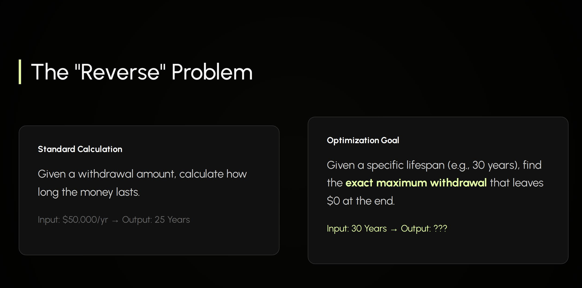
Your part
Type here

Slide 19
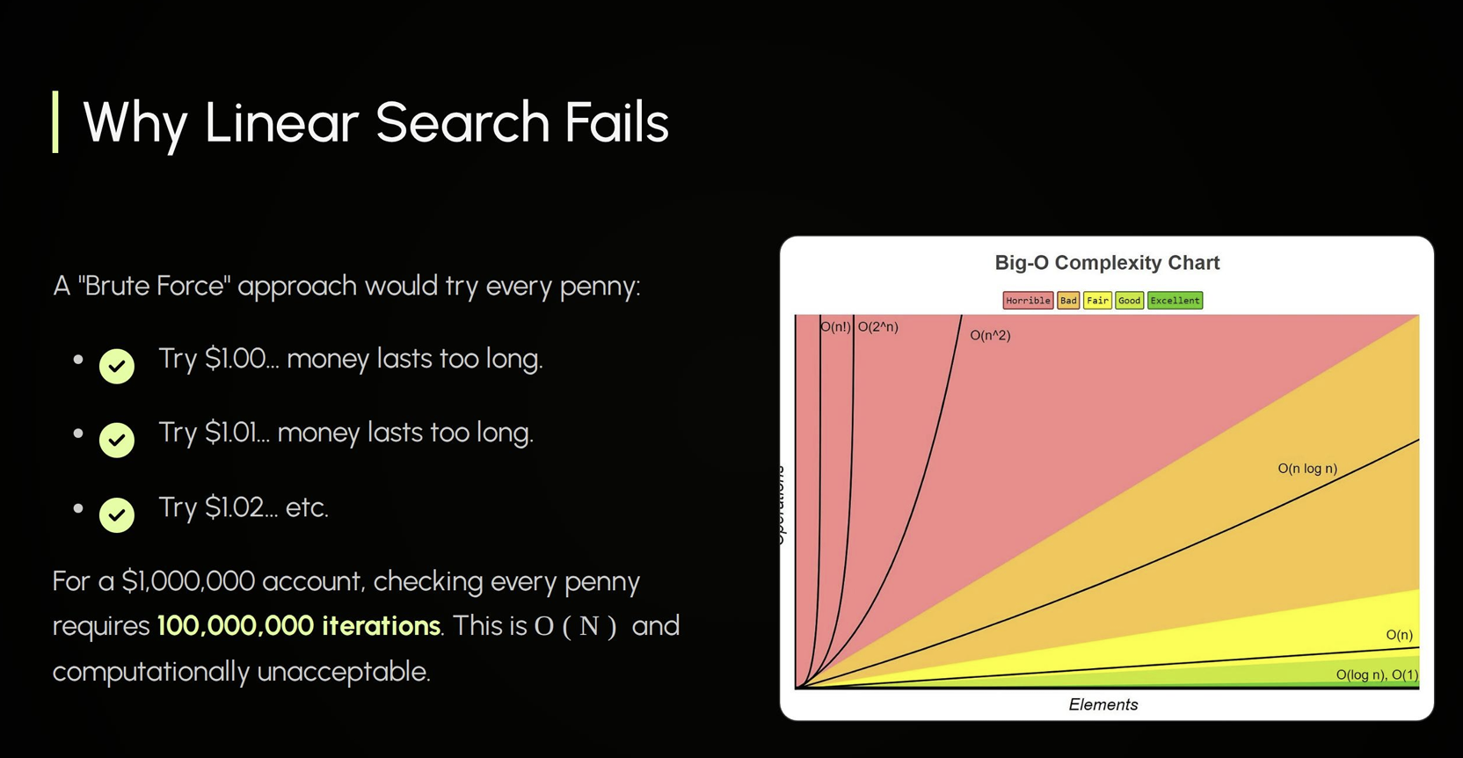

Slide 20
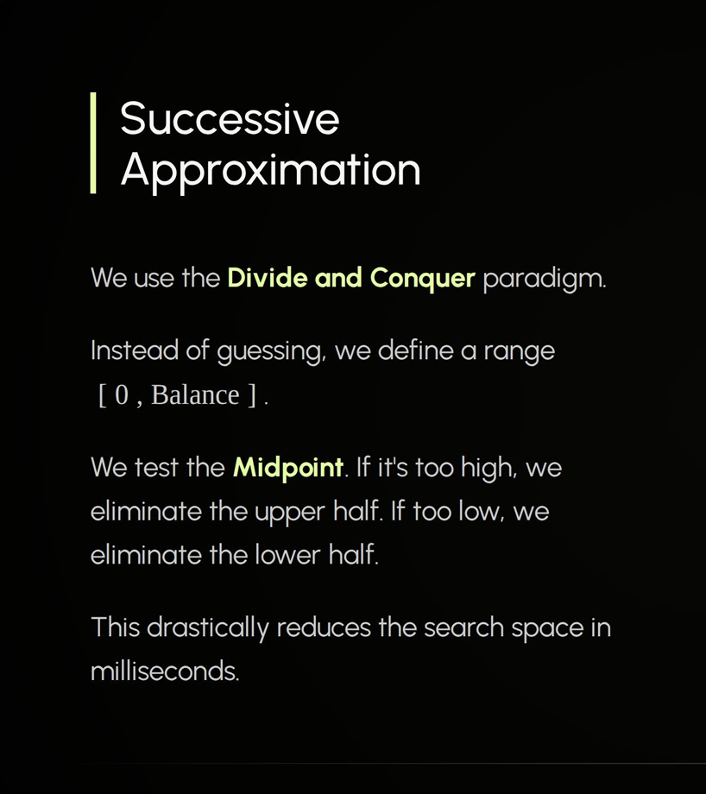

Slide 21
06
Code Demonstration

Slide 22
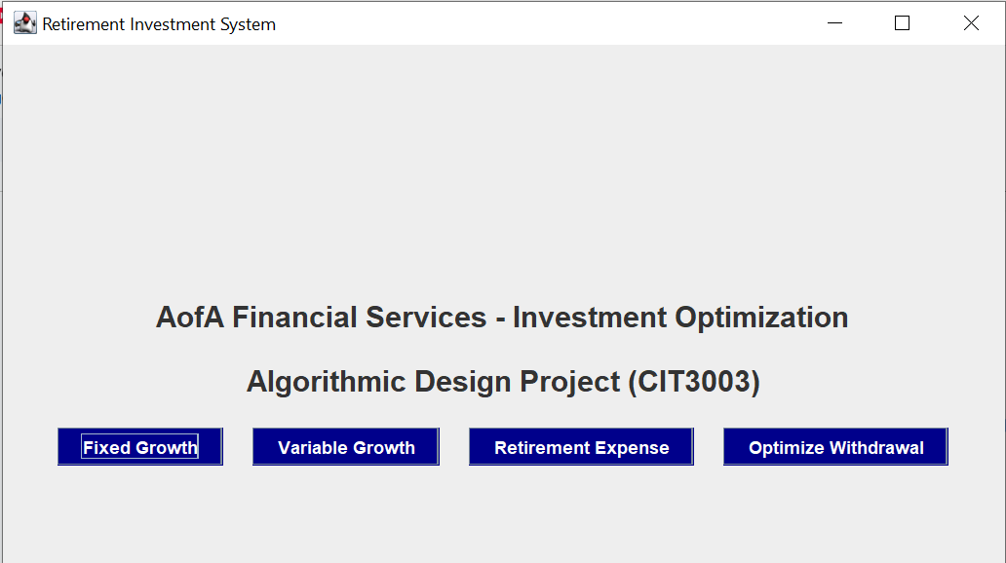

Slide 23
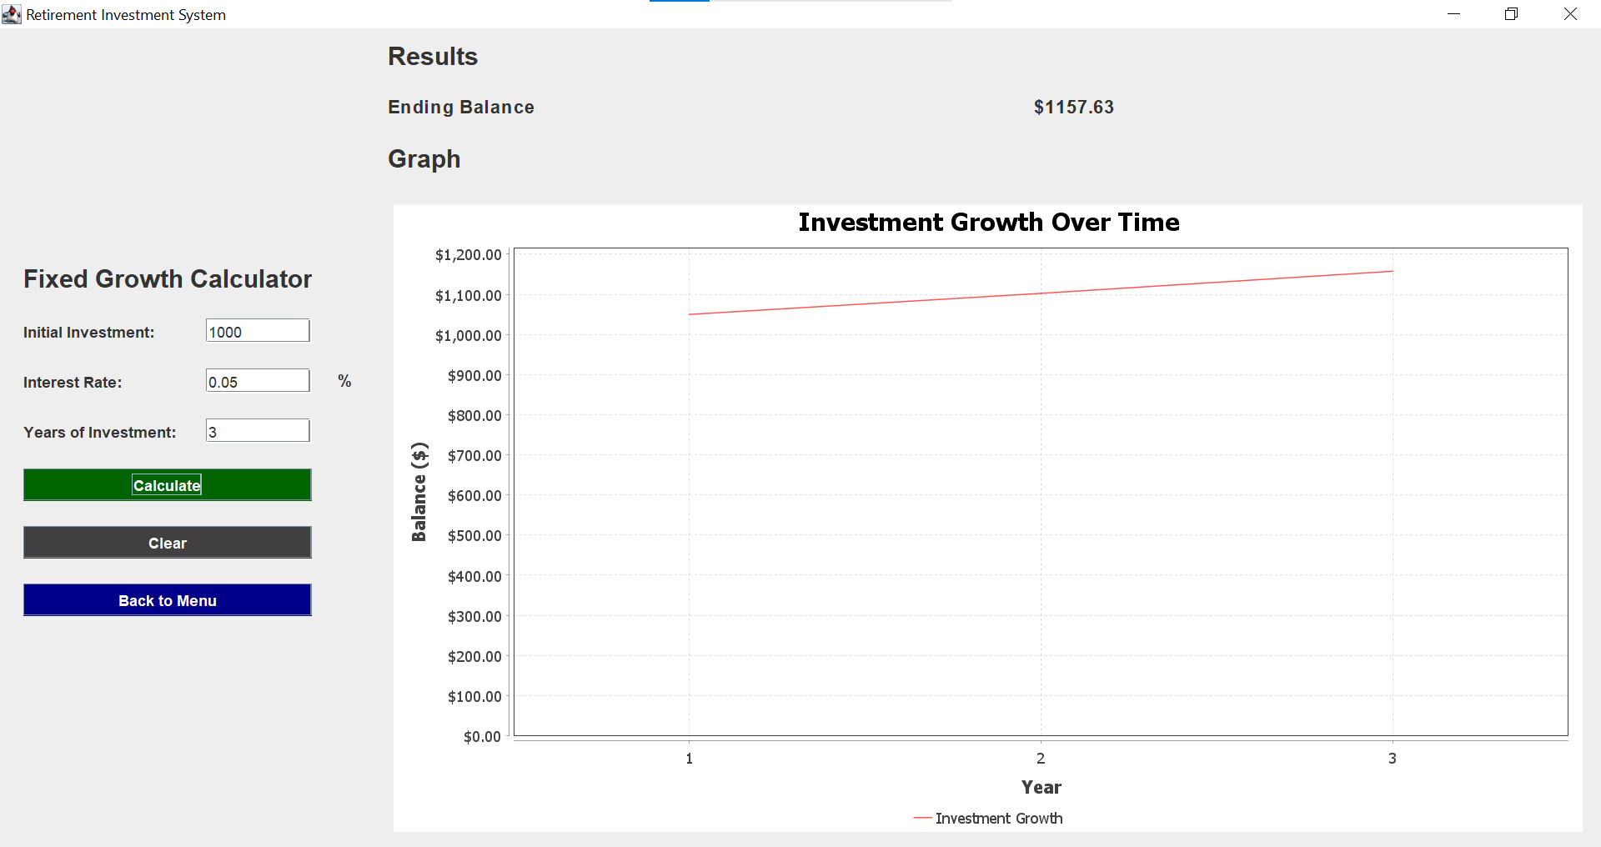
Fixed Investor Test Data
Balance = 1000
Rate = 0.05
Years = 3
Expected End Balance = 1157.63

Slide 24
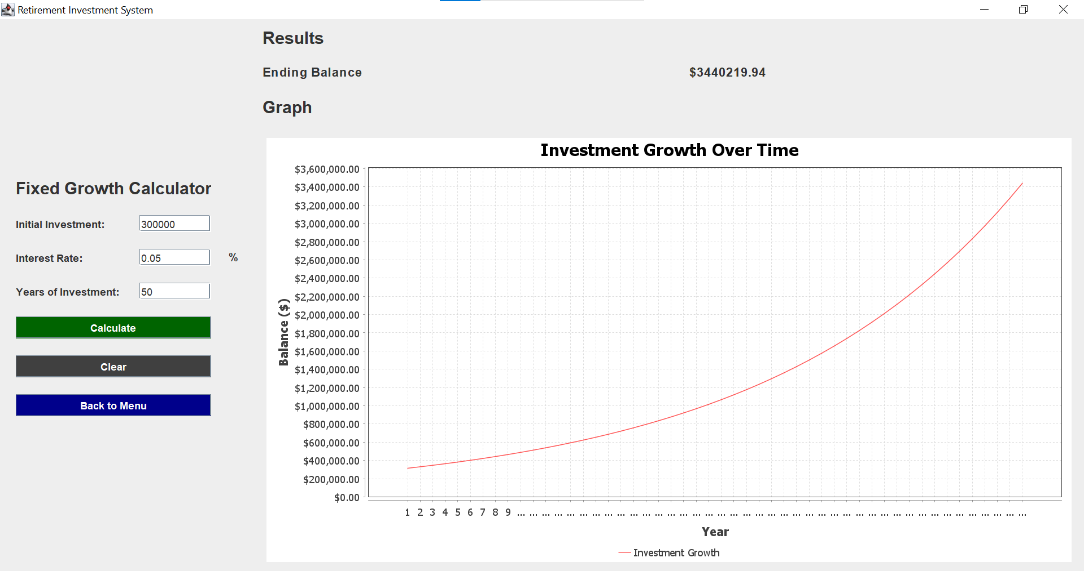
Fixed Investor Test Data
Balance = 300,000
Rate = 0.05
Years = 50
Expected End Balance = 3,440,219.94

Slide 25
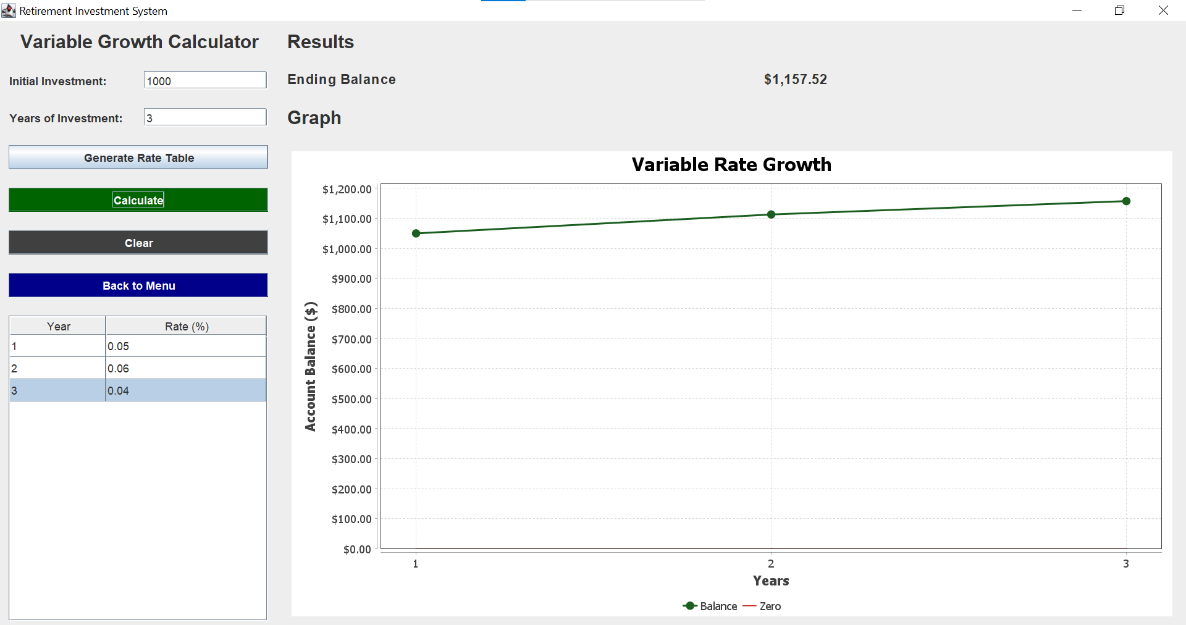
Variable Investor Test Data
Principal = 1000
RateList[] = [0.05,0.06,0.04]
Expected End Balance = 1157.52

Slide 26
Variable Investor Test Data
Principal = 50,000
RateList[] = [0.05,0.09, 0.01, 0.06, 0.08]
Expected End Balance = 66,166.39

Slide 27
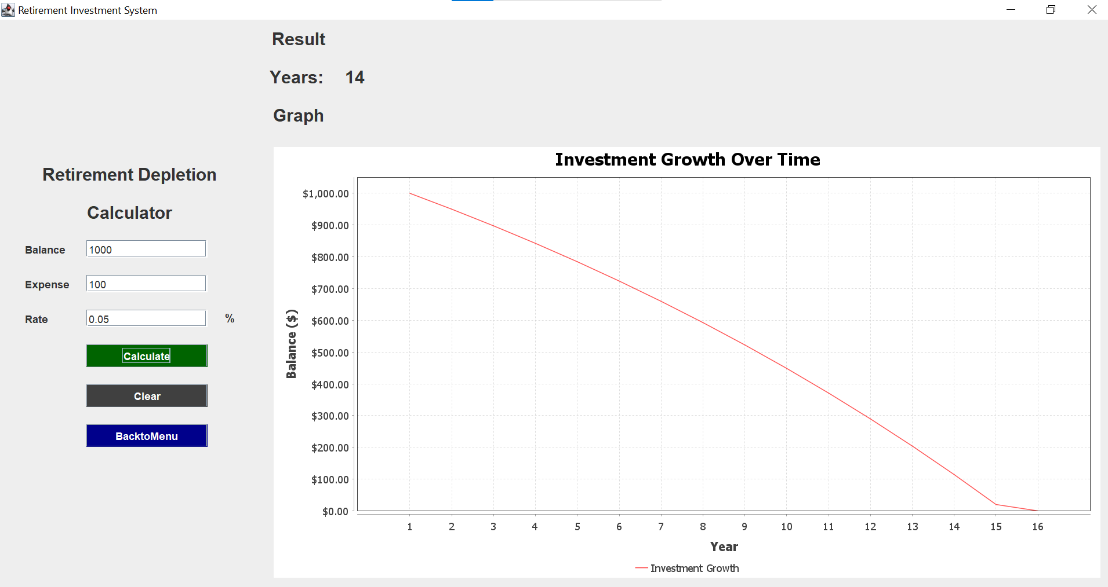
Finally Retired Test Data
Balance = 1000
Expense = 100
Rate = 0.05
Expected Years Lasted: 14 yrs

Slide 28
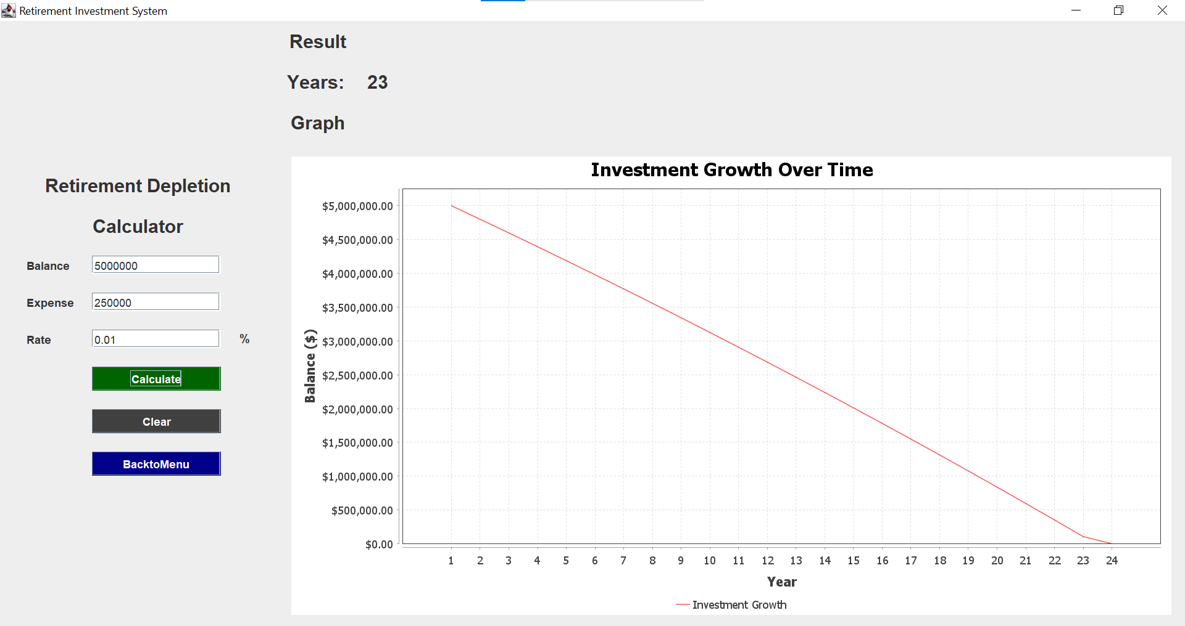
Finally Retired Test Data
balance = 5,000,000
rate= [0.01]
expense= [250,000]
Expected Years = 23

Slide 29
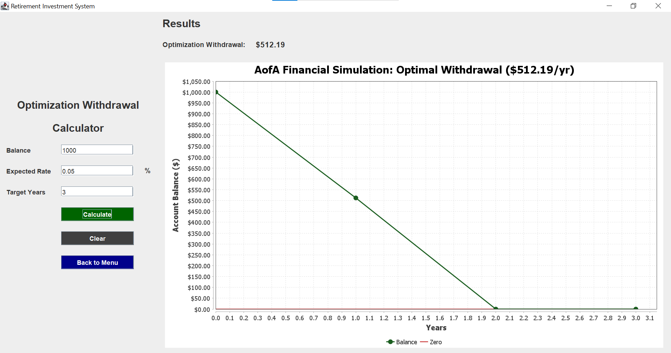
Maximum Expensed Test Data
Balance = 1000
Rate = 0.05
Years = 3

Slide 30
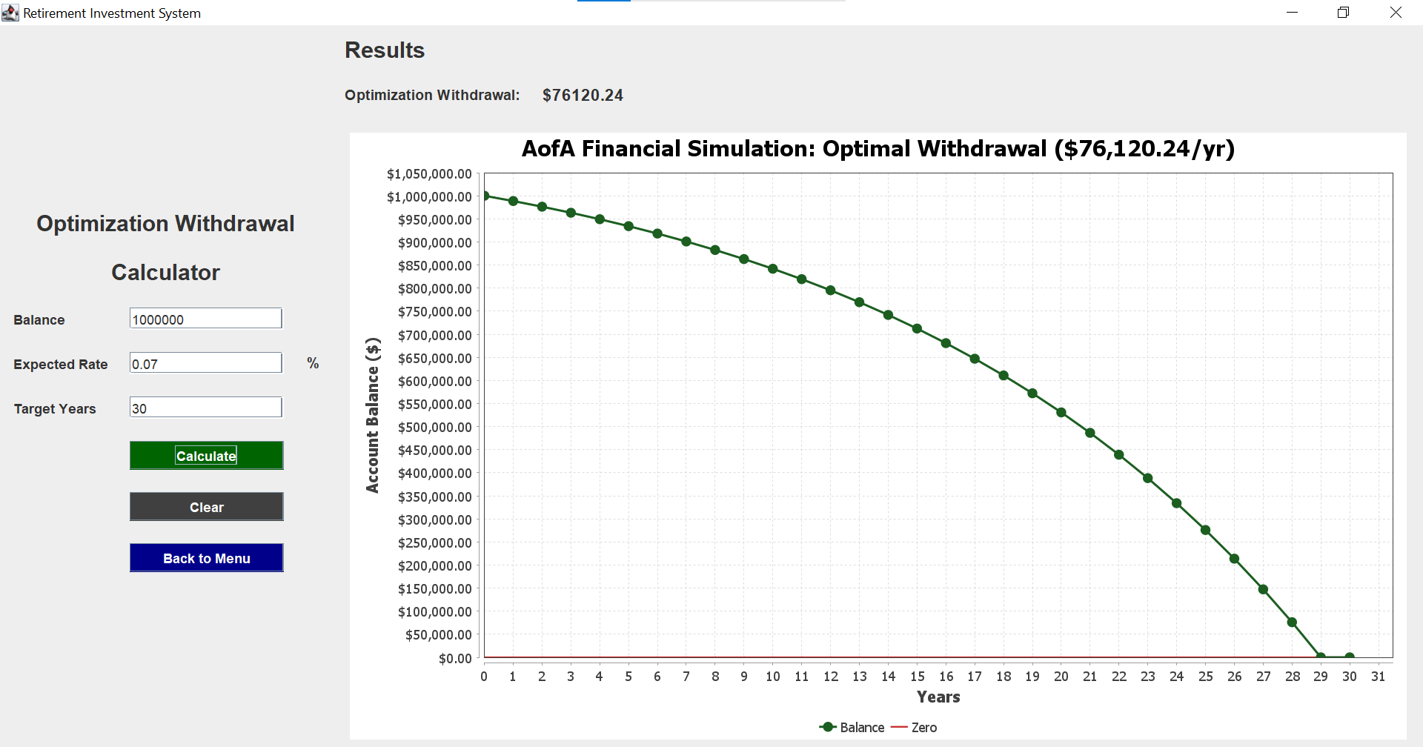
Maximum Expensed Test Data
Balance = 1,000,000
Rate = 0.07
Years = 30

Slide 31
THE END

